Slide 1


DOCSY
Improving lives together

Slide 2

Our objective
Our mission is to provide a user friendly healthcare platform for storing, reviewing and downloading electronic health records of patients.

Slide 3

PRODUCT FEATURES
Add patient report
Download report
Doctor can deal with prescriptions & reports of the patients.
Patient can download the prescription & lab reports, book an appointment.
Appointment booking
Medical history
Patient can book an appointment for a particular doctor based on speciality.
Both, doctor and patient can view medical history of a particular patient.

Slide 4

PROJECT OVERVIEW

Slide 5
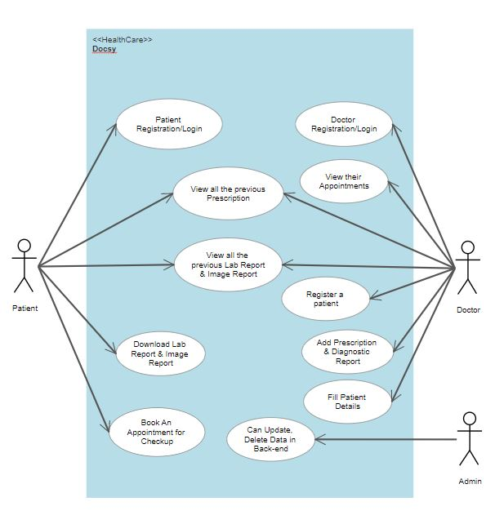

USE-CASE DIAGRAM

Slide 6
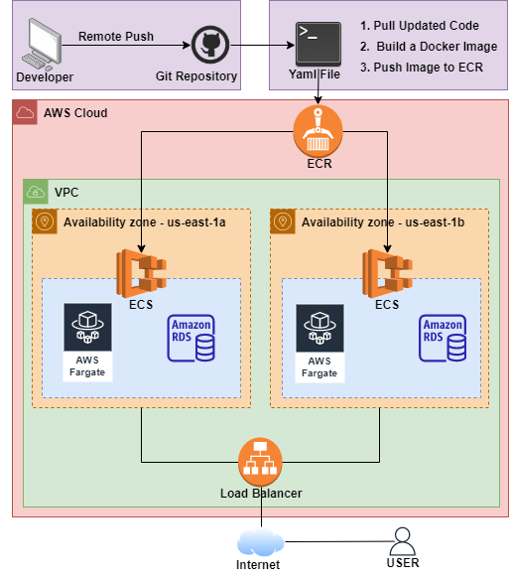
ARCHITECTURE

Slide 7
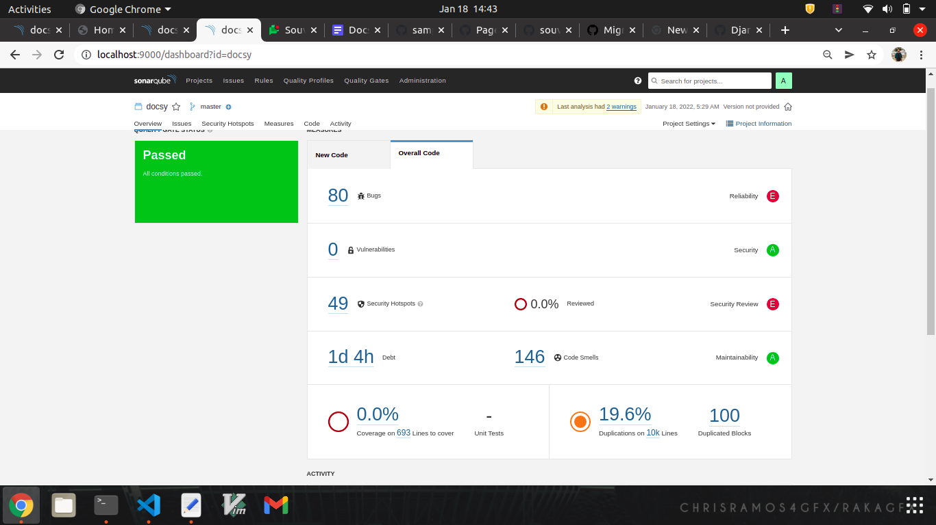
SONARQUBE REPORT

Slide 8
TECHNOLOGY STACK
FRONTEND
Backend
HTML5
CSS3
JavaScript
Bootstrap
J-Query
Django
Django Template
database
Postgres + Sqlite3
Testing
devops
Selenium with Django LiveServerTestCase
Sonarqube
Amazon AWS(ECR, ECS, Fargate)
Version control
Git

Slide 9
FUTURE PROSPECTIVE
ADD PHARMACIST ROLE
ADD MEDICAL WORKER
SERVICES
Can add video consolation & notification service
FAMILY RECORDS
Store family wise all the history of medical records

Slide 10

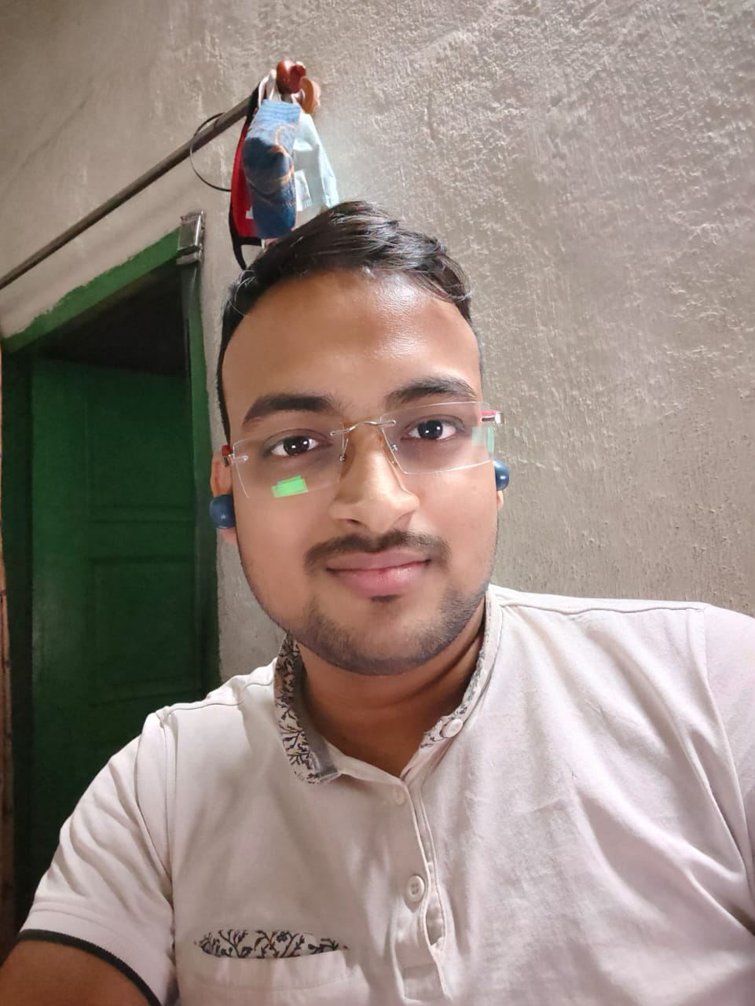
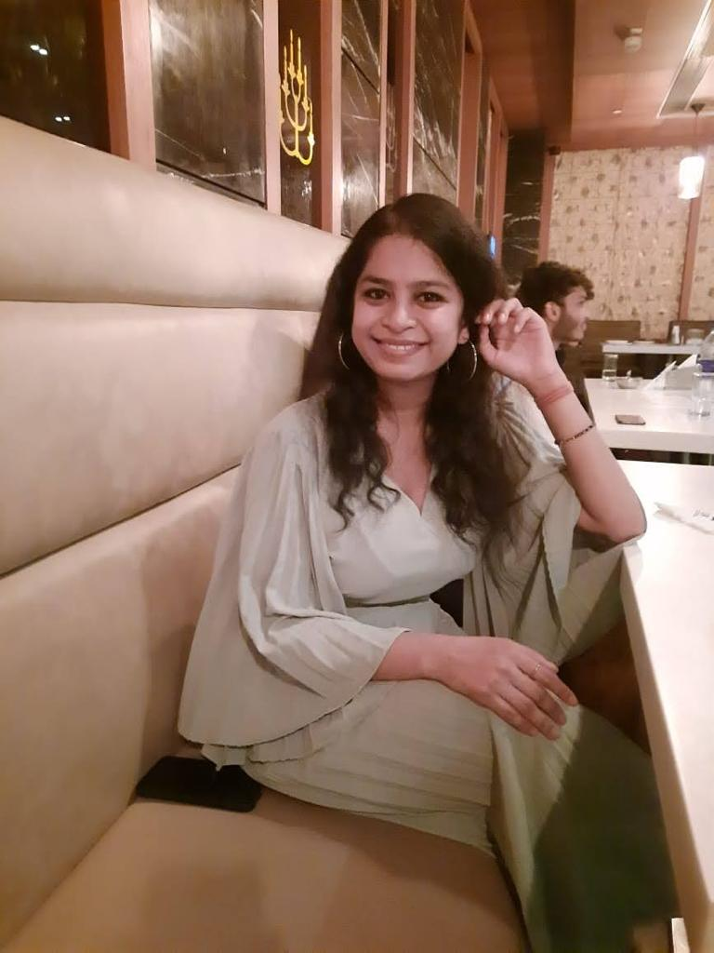



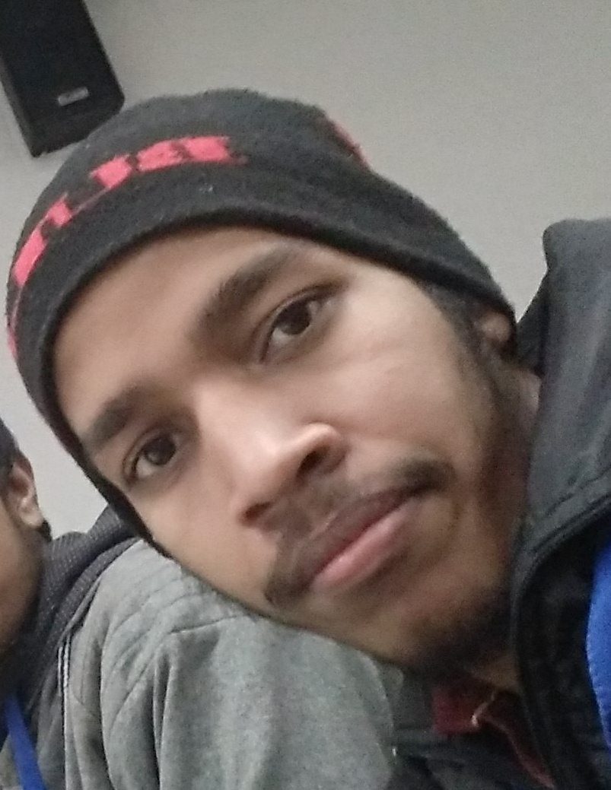
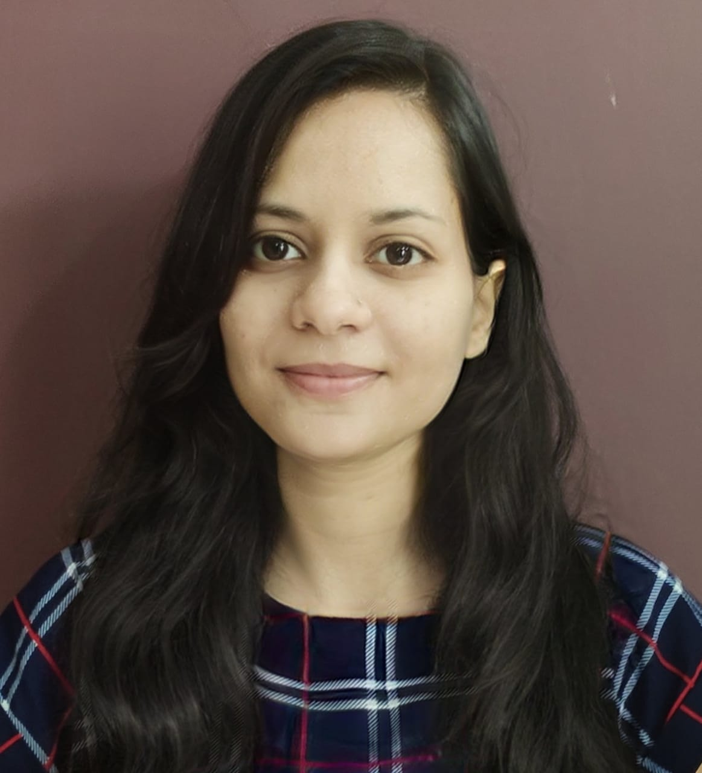
Raghib
SOUVIK
Kirti
sushanth
Deployment
Backend Development
Backend Development
Backend Development
THE FULL TEAM
Pavan
Suraj
Shailesh
Akanksha
Backend Development
Backend Development
Frontend Development
Frontend Developer​

Slide 11

DOCSY
+1 234567890
docsy@sample.com​
www.docsy.com​
THANK YOU

